Slide 1

Gujarat-Demographic Voting pattern and the help of AAP to the BJP in ensuring the defeat of the Congress Party

Slide 2
BJP PERFORMANCE IN 2017 AND 2022

Slide 3
COMPARISON INCREASE OF BJP % VOTE SHARE AND SEATS

Slide 4
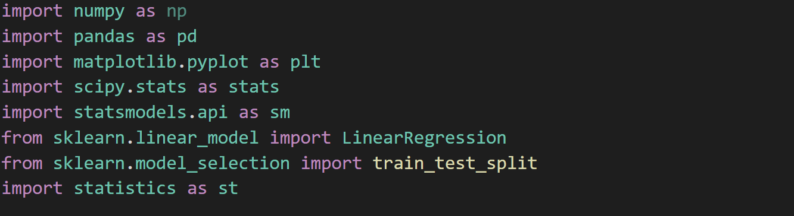
LIBRARIES USED

Slide 5


USER PROMPTS

Slide 6
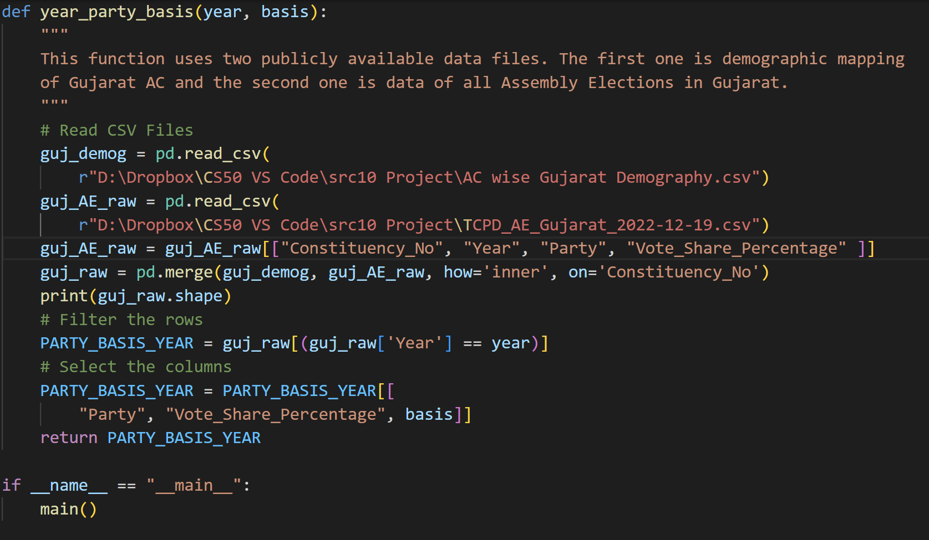
THE FUNCTION year_party_basis()

Slide 7
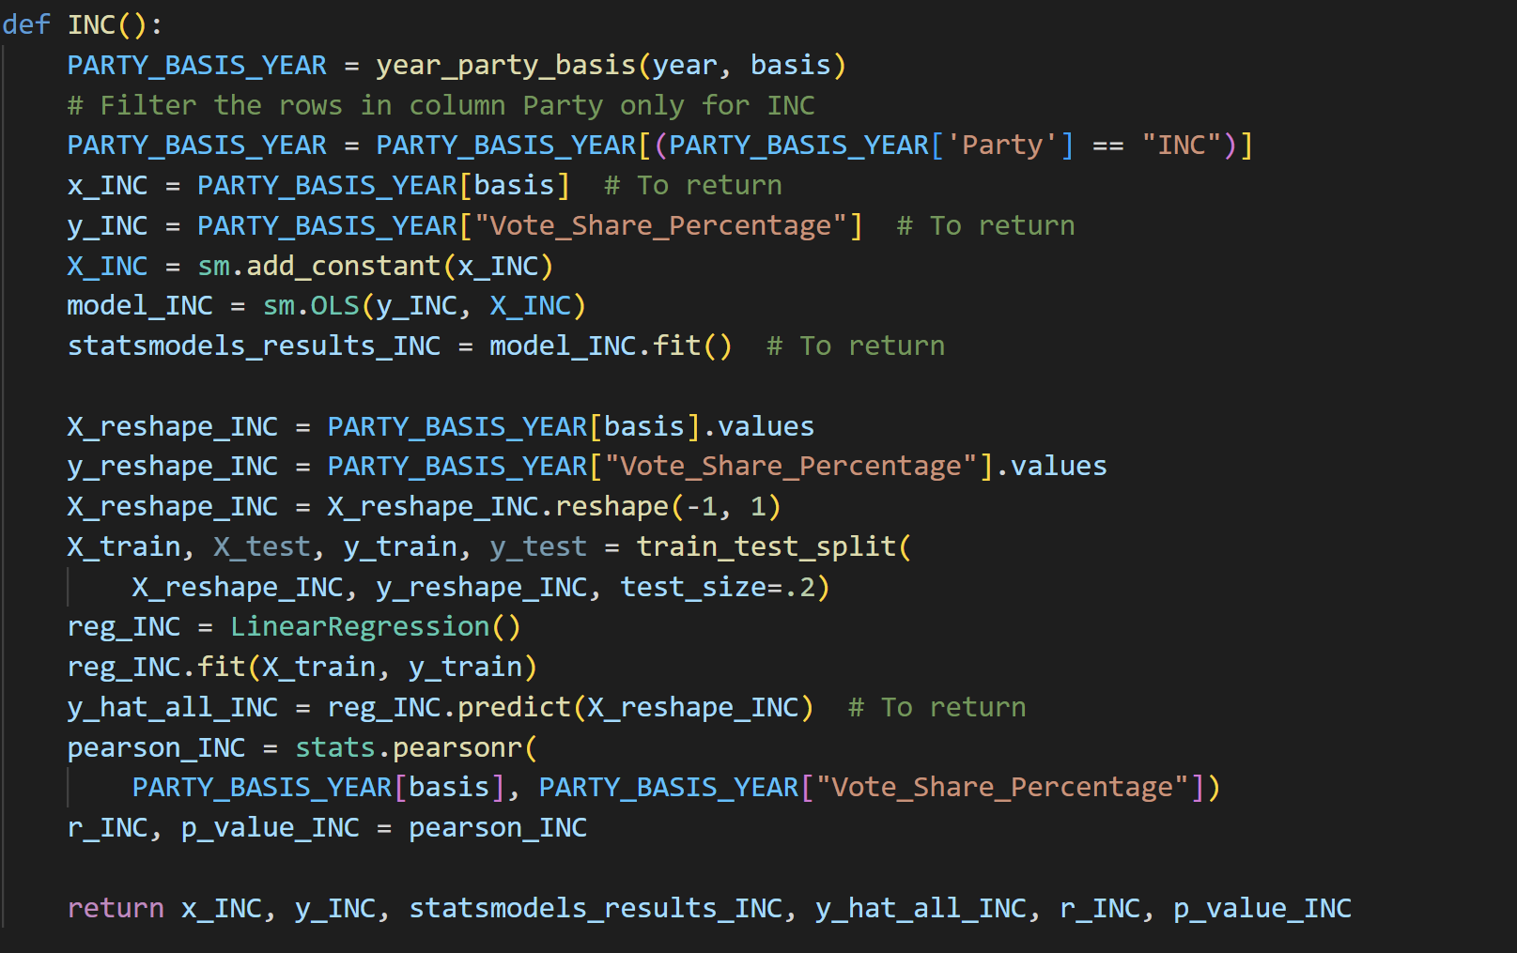
PARTY FUNCTIONS e.g. INC()

Slide 8
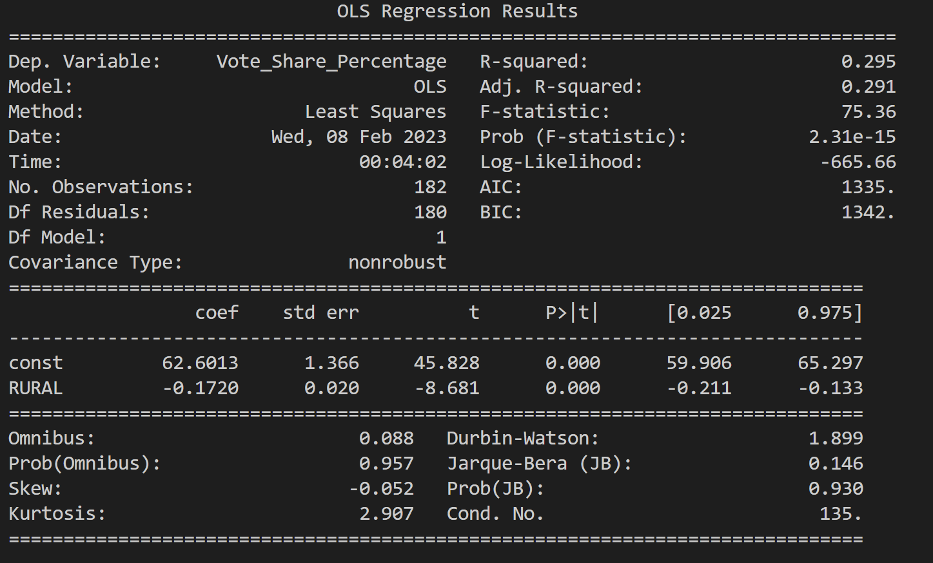
Summary Statistics

Slide 9
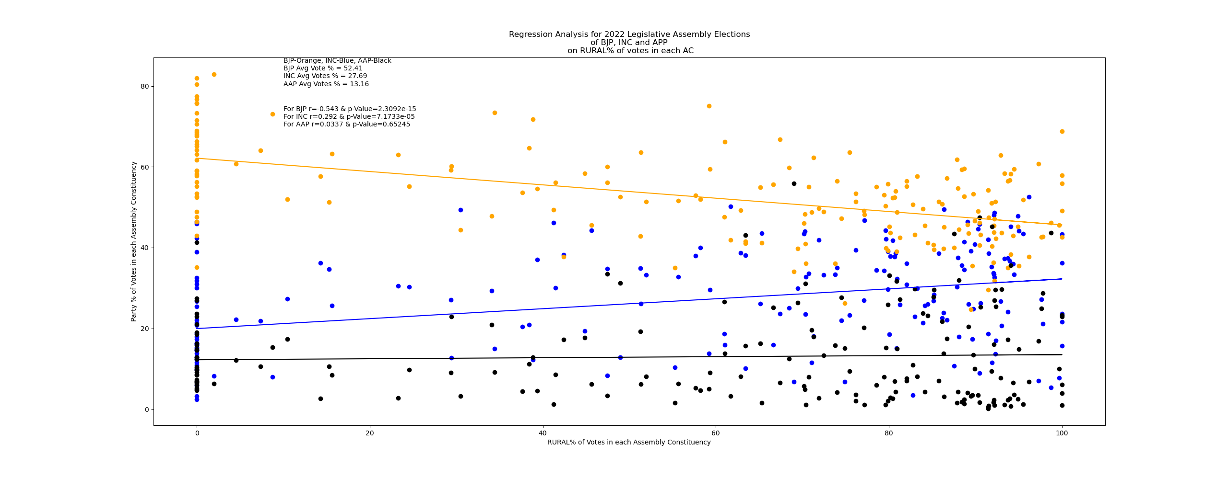

Slide 10
